Slide 1

PANIMALAR ENGINEERING COLLEGE
Department of Computer Science and Engineering
CS8811 PROJECT WORK
Signature-Based Public Sensitive Data Sharing for Cloud Storage
Project Guide:
Team Members:
Mrs.A.Kanchana.M.E.
Assistant Professor
1. SRIRAM.R – 2019PECCS255
2. RITHIK.M R – 2019PECCS233
3. VIJAY VIKRAMAN.V – 2019PECCS276

Slide 2
Abstract:
To ensure information security, the information proprietor necessities to check the respectability of information put away somewhat in the cloud server with the public examining method. In reality the staff needs to enlist here and it will tell to the group chief who needs to support to their worker. In the future who can login in this application in light of group like A, B, C, D. The group can share the venture subtleties to a workers. In the event that the subtleties added by Group A representative's, it will tell to Group A worker's not to other people. Before that the group chief added by the administration and keep up with the group chief's subtleties. The staff could ready to see the encoded subtleties just not the first happy it will be changed over completely to cryptography design. Cryptography is procedure of getting data and correspondences through utilization of codes with the goal that main those individual for whom the data is planned can grasp it and interaction it. The solicitation of staffs move to the group chief who needs to support it then, at that point, moved to the administration who will check staff subtleties and group pioneers. After the endorsement the staff can recover the information utilizing the QR. A QR code is a sort of standardized identification that can be perused effectively by a computerized gadget and which stores data as a progression of pixels in a square-formed matrix.

Slide 3
INTRODUCTION:
Sensitive data transaction is confidential information that must be kept safe and out of reach from all outsiders unless they have permission to access it. Access to sensitive data should be limited through sufficient data security and information security practices designed to prevent data leaks and data breaches. Sensitive data can be any sort of information that needs to be protected from unauthorized access to safeguard the privacy or security of an individual or organisation. It can include any information pertaining to: Passwords.

Slide 4
LITERATURE SURVEY
YEAR | AUTHOR(S) | PAPER TITLE | METHODOLOGY
2015 | Xie Suping , Chen Huaichu , Luo Nainlong, Zhang Huilin | Research of Data Sharing between Applications Base on User Request | This paper presents an implementation for data sharing between applications based on asymmetric encryption algorithms, digital signature. It also provides a new idea of data sharing between applications. It can be a supplementary program for data sharing. It can be an effective solution to solve the problem of sensitive personal data grant between applications data and can be used for proof of personal income data, statistical data sharing and the like.

Slide 5
YEAR | AUTHOR(S) | TITLE | METHODOLODY | MERITS/DEMRITS
2019 | Keiic Keiichi Iwamura and Ahmad Akmal Aminuddin Mohd Kamalhi Iwamura and Ahmad Akmal Aminuddin Mohd Kamal | Secure Computation by Secret Sharing using Input Encrypted with Random Number. | In this paper :(1) the result of secure computation does not include 0; (2) random numbers reconstructed by each server are fixed; and (3) each server holds random numbers unknown to the adversary and holds shares of random numbers that make up the random numbers unknown to the adversary. In this paper, we show that by leaving condition. | MERITS: One of the advantages is the acceleration of the computation time. Namely, we divide the computation process into a preprocessing phase and an online phase and shift the cost of communication to the preprocessing phase

Slide 6
YEAR | AUTHOR(S) | TITLE | METHODOLODY | MERITS/DEMERITS
2020 | Nileshkumar Kakade; Utpalkumar Patel | Secure Secret Sharing Using Homomorphic Encryption | Secret sharing deals with splitting a secret information with various players. The goal of the secret sharing is security of secret, privacy and hiding information. There are numerous techniques available for secret sharing e.g. polynomial, Chinese remainder theorem, vector space, matrix projection. Techniques have characteristics like threshold, proactive, verifiable. Proactive secret sharing scheme allow user to change share in case of doubt of theft. | MERITS: Our schemes unique features is share can be renewed any time, Each party can choose secret of their own choice

Slide 7
YEAR | AUTHOR(S) | TITLE | METHODOLOGY
2015 | Sundari S, Ananthi M | Secure multi-party computation in differential private data with Data Integrity Protection | Secure multiparty computation (SMC) is needed now-a-days in which data are distributed between different parties. Moreover, organizations are wished to collaborate with other parties who conduct same business, for their mutual benefits. Two Phase Validation (2PV) provides the authentication for the users, while integrating the data in multiparty computation. Data can get corrupted due to some malfunctions

Slide 8
YEAR | AUTHOR(S) | TITLE | METHODOLOGY
2017 | Anmin Fu; Shui Yu; Yuqing Zhang; Huaqun Wang; Chanying Huang | A New Privacy-Aware Public Auditing Scheme for Cloud Data Sharing with Group Users | Today, cloud storage becomes one of the critical services, because users can easily modify and share data with others in cloud. However, the integrity of shared cloud data is vulnerable to inevitable hardware faults, software failures or human errors. To ensure the integrity of the shared data, some schemes have been designed to allow public verifiers (i.e., third party auditors) to efficiently audit data integrity without retrieving the entire users’ data from cloud.

Slide 9
YEAR | AUTHOR(S) | TITLE | METHODLOGY
2020 | DONGJIE LIU AND JONG-HYOUK LEE | CNN Based Malicious Website Detection by Invalidating Multiple Web Spams | Although a variety of techniques to detect malicious websites have been proposed, it becomes more and more diffcult for those methods to provide a satisfying result nowadays. Many malicious websites can still escape detection with various Web spam techniques. In this paper, we first summarize three types of Web spam techniques used by malicious websites, such as redirection spam, hidden I Frame spam, and content hiding spam. The proposed detection method uses a Convolutional Neural Network, which is a class of deep neural networks, as a classification algorithm.

Slide 10
EXISTING SYSTEM
A public auditing scheme that supports sensitive data sharing for the cloud environment. In our scheme, the data owner’s privacy can be protected while sharing data. The integrity checking of the remotely stored data in the cloud server can also be executed efficiently. The security analysis shows that our proposed scheme is more secure compared to that of related works, and several experiments show that our scheme achieves a desirable efficiency.
TECHNIQUE
Bilinear pairing and cryptographic difficult problems
DISADVANTAGE
It takes a long time to process function methods.

Slide 11
PROPOSED SYSTEM
We propose another plan in light of the redactable signature. In our proposed plot, the cloud server can
change the mark straightforwardly without the extra sanitizer while sharing delicate information.
TECHNIQUE
RSA algorithm. SQL Operation
ADVANTAGE
It gives a standard and valid solution to process the data with has to function

Slide 12
HARDWARE REQUIREMENTS
The hardware requirements may serve as the basis for a contract for the implementation of the system and should therefore be a complete and consistent specification of the whole system. They are used by software engineers as the starting point for the system design. It shows what the system does and not how it should be implemented.
PROCESSOR : PENTIUM IV 2.6 GHz, Intel Core 2 Duo.
RAM : 4GB DD RAM
MONITOR : 15” COLOR
HARD DISK : 40 GB

Slide 13
SOFTWARE REQUIREMENTS
The software requirements document is the specification of the system. It should include both a definition and a specification of requirements. It is a set of what the system should do rather than how it should do it. The software requirements provide a basis for creating the software requirements specification. It is useful in estimating cost, planning team activities, performing tasks and tracking the team’s and tracking the team’s progress throughout the development activity.
Front End : J2EE (JSP, SERVLETS) JAVASCRIPT
Back End : MY SQL 5.5
Operating System : Windows 07
IDE : Eclipse

Slide 14
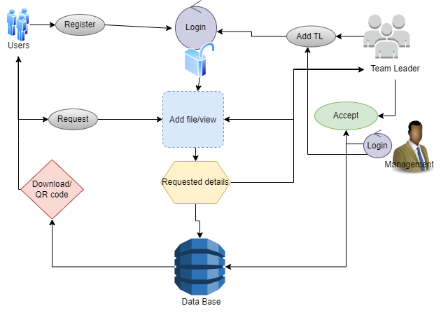
SYSTEM ARCHITECTURE:
EXPLANATION:
The systems architect establishes the basic structure of the system, we propose a Hash code Solomon algorithm and we can put a small part of data in local machine and fog server in order to protect the privacy. Moreover, based on computational intelligence, this algorithm can compute the distribution proportion stored in cloud, fog, and local machine, respectively. Through the theoretical safety analysis and experimental evaluation, the feasibility of our scheme has been validated, which is really a powerful supplement to existing cloud storage scheme

Slide 15

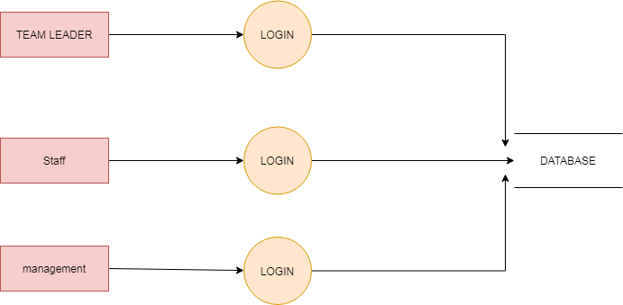
DATA FLOW DIAGRAM:
LEVEL 1:
LEVEL 2:

Slide 16
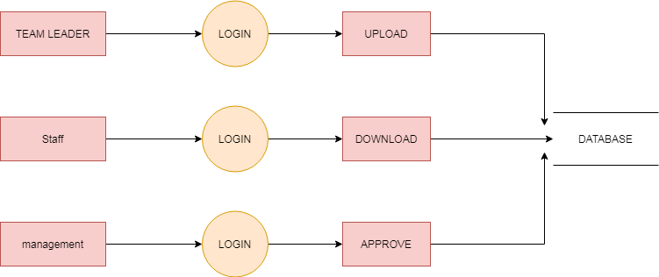
LEVEL 3:
EXPLANATION:
A data flow diagram (DFD) is a graphical representation of the “flow” of data through an information system. It differs from the flowchart as it shows the data flow instead of the control flow of the program. A data flow diagram can also be used for the visualization of data processing. The DFD is designed to show how a system is divided into smaller portions and to highlight the flow of data between those parts.

Slide 17
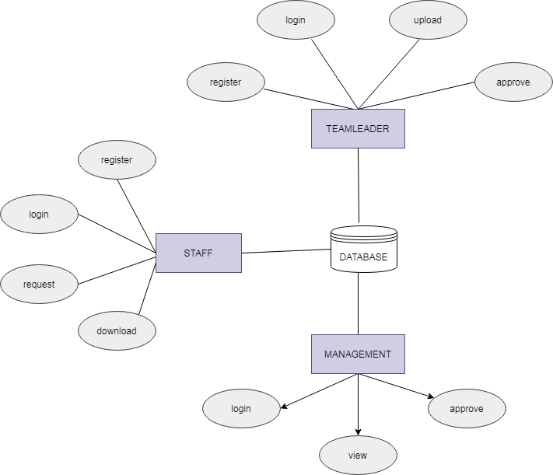
E-R DIAGRAM:

Slide 18
MODULES
STAFF REGISTER
STAFF LOGIN
STAFF FILE VIEW
STAFF FILE REQUEST
STAFF FILE DOWNLOAD
TEAM LEADER LOGIN
TEAM LEADER FILE UPLOAD
TEAM LEADER FILE VIEW
MANAGEMENT LOGIN
MANAGEMENT TEAM LEADER REGISTRATION
MANAGEMENT GENERATE KEY
MANAGEMENT RESPONSE

Slide 19
MODULE EXPLANTION
STAFF REGISTER
The register module provides a conceptual framework for entering data on those staff in a way that: eases data entry & accuracy by matching the staff entry to the data source (usually paper files created at point of care), ties easily back to individual staff records to connect registers to staff data, and collects data elements to enable better supervision of donation programs.
STAFF LOGIN
In this module in our project, here symbolizes a unit of work performed within a database management system (or similar system) against a database, and treated in a coherent and reliable way independent of other transactions. A transaction generally represents any change in database user will transfer the amount to provider.
DATABASE
STAFF
REGISTER
DATABASE
STAFF
LOGIN
HOME PAGE

Slide 20
STAFF FILE VIEW
In this module the staff will also view the team leader added file. And analysis the details will be responsible for your file stored in database.
STAFF FILE REQUEST
In this module is used to help to the staff to Request for download file with the land longitude and the user will update the report along with their opinion and the will be stored the database.
STAFF FILE DOWNLOAD
In this module the staff download the file after management accept the request. It will be stored on local storage.
DATABASE
STAFF
VIEW FILE
DATABASE
STAFF
REQUEST
REQUEST VIEW
DATABASE
STAFF
DOWNLOAD
LOCAL STORAGE

Slide 21
TEAM LEADER LOGIN
In this module in our project, here symbolizes a unit of work performed within a database management system (or similar system) against a database, and treated in a coherent and reliable way independent of other transactions. A transaction generally represents any change in database user will transfer the amount to provider.
TEAM LEADER FILE UPLOAD
The team leader can then select a file from their computer and click the Upload button to submit the file to the server. The Java file upload Servlet will then capture that file and persist. It will be stored in database.
DATABASE
TEAM LEADER
LOGIN
HOME PAGE
ADD FILE
DATABASE
TEAM LEADER

Slide 22
TEAM LEADER FILE VIEW
This module to help us the staff add the file to the staffs. The data directly stored in database. Then staff will view the uploaded file.
MANAGEMENT LOGIN
In this module in our project, here symbolizes a unit of work performed within a database management system (or similar system) against a database, and treated in a coherent and reliable way independent of other transactions. A transaction generally represents any change in database user will transfer the amount to provider.
DATABASE
TEAM LEADER
VIEW FILE
DATABASE
MANAGEMENT
LOGIN
HOME PAGE

Slide 23
MANAGEMENT TEAM LEADER REGISTRATION
The register module provides a conceptual framework for entering data on those team leader in a way that: eases data entry & accuracy by matching the team leader entry to the data source (usually paper files created at point of care), ties easily back to individual team leader records to connect registers to team leader data, and collects data elements to enable better supervision of team programs.
MANAGEMENT GENERATE KEY
In this module the management generate key for the staff request. Because the key for the security purpose. After get the key from management the staff will download the file with key.
MANAGEMENT RESPONSE
In this module the bank will response the data file fully analyzed data in category wise view Bank will be responsible for your file stored in database.
DATABASE
MANAGEMENT
ADD TEAM LEADER
TEAM LEADER LOGIN
MANAGEMENT
GENERATE KEY
STAFF
MANAGEMENT
RESPONSE
DATABASE
STAFF

Slide 24
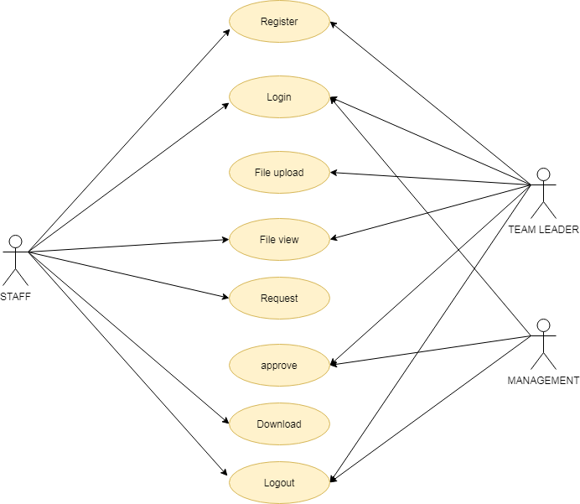
USE CASE
EXPLANATION
The use case diagram is the main building block of object oriented modeling. It is used both for general conceptual modeling of the systematic of the application, and for detailed modeling translating the models into programming code. For this in our component diagram first propose a data In this proposed method we are using Hash-Solomon Code Algorithm to encrypt the data.

Slide 25
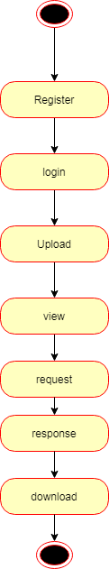
STATE DIAGRAM
EXPLANATION
State diagrams require that the system described is composed of a finite number of states; sometimes, this is indeed the case, while at other times this is a reasonable abstraction. Many forms of state diagrams exist, which differ slightly and have different semantics. In our state diagram first propose a . For this in our component diagram first propose a data In this proposed method we are using Hash-Solomon Code Algorithm to encrypt the data.

Slide 26
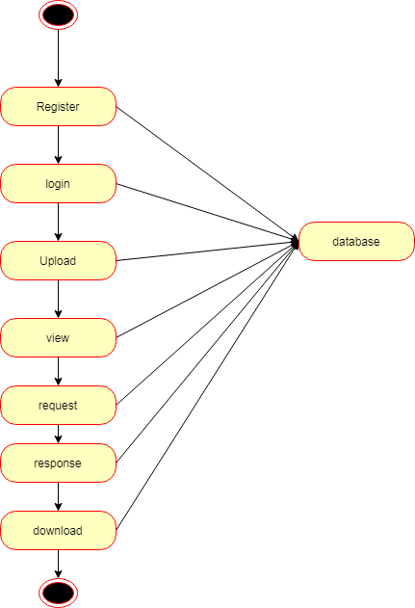
ACTIVITY DIAGRAM
EXPLANATION
Activity diagram are a loosely defined diagram to show workflows of stepwise activities and actions, with support for choice, iteration and concurrency. UML, activity diagrams can be used to describe the business and operational step-by-step workflows of components in a system. UML activity diagrams could potentially model the internal logic of a complex operation. In many ways UML activity diagrams are the object-oriented equivalent of flow charts and data flow diagrams (DFDs)from structural development.

Slide 27
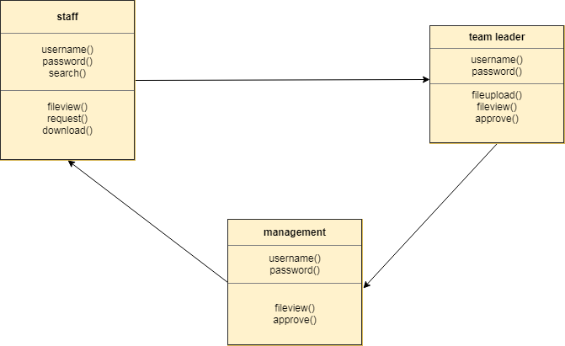
CLASS DIAGRAM
EXPLANATION
Class diagram is a type of static structure diagram that describes the structure of a system by showing the system's classes, their attributes, and the relationships between the classes. The classes in a class diagram represent both the main objects and or interactions in the application and the objects.

Slide 28
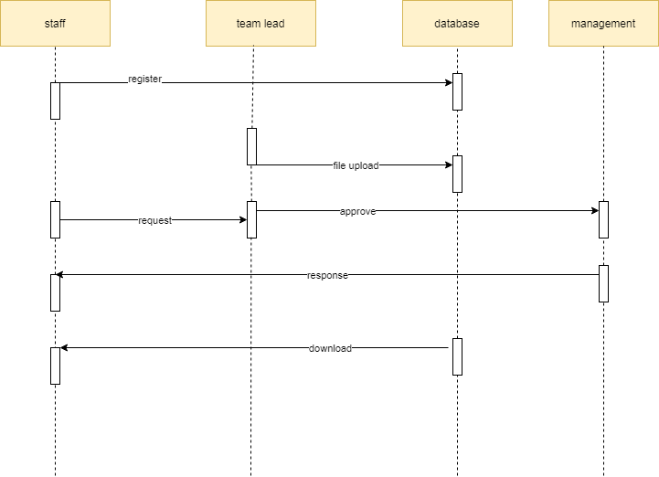
SEQUENCE DIAGRAM
EXPLANATION
In our sequence diagram specifying processes operate with one another and in order. In our sequence diagram first propose For this in our component diagram first propose a data In this proposed method we are using Hash-Solomon Code Algorithm to encrypt the data.

Slide 29

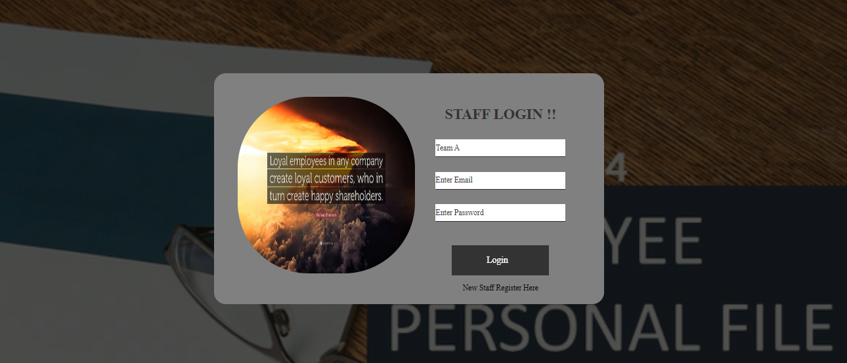
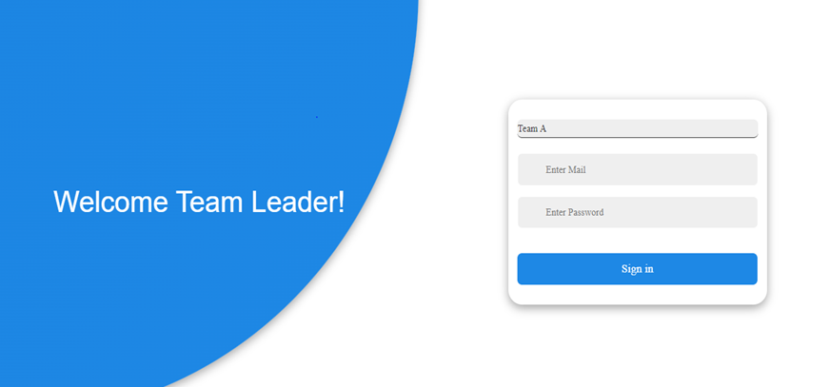


Slide 30


Slide 31
FUTIRE ENHANCEMET
Implementing a real-world anonymous database system.
Improving the efficiency of protocols, in terms of number of messages exchanged and in terms of their sizes, as well.
Implement using two algorithms.
CONCLUSION
Data sensitivity concerns information that should be protected from unauthorized access or disclosure due to its sensitive nature. For some, that might be Team leader, Staff details records. Sensitive data is confidential information that must be kept safe and out of reach from all outsiders unless they have permission to access it. Access to sensitive data should be limited through sufficient data security and information security practices designed to prevent.

Slide 32
REFERENCES:
[1] P. J. Taylor, T. Dargahi, A. Dehghantanha, R. M. Parizi, and K. K. R. Choo, “A systematic literature review of blockchain cyber security,” Digital Communications and Networks, vol. 6, no. 2, pp. 147-156, 2020.
[2] D. Liu and J. Lee, “CNN based Malicious Website Detection by Invalidating Multiple Web Spams,” IEEE Access, vol. 8, no. 1, pp. 97258-97266, 2020.
[3] W. Martin, V. Friedhelm, and K. Axel, “Tracing manufacturing processes using blockchain-based token compositions,” Digital Communications and Networks, vol. 6, no 2, pp. 167-176, 2019.
[4] D. Puthal, N. Malik, S. P. Mohanty, E. Kougianos and G. Das, “Everything You Wanted to Know About the Blockchain: Its Promise, Components, Processes, and Problems,” IEEE Consumer Electronics Magazine, vol. 7, no. 4, pp. 6-14, 2018.
[5] L. Peng, W. Feng, and Z. Yan. (2020). Privacy preservation in permissionless blockchain: A survey. Digital Communications and Networks. [Online]. Available: https://doi.org/10.1016/j.dcan.2020.05.008.
[6] Anmin Fu; Shui Yu; Yuqing Zhang; Huaqun Wang; Chanying Huang,” A New Privacy-Aware Public Auditing Scheme for Cloud Data Sharing with Group Users”
[7] Sundari S, Ananthi M,” Secure multi-party computation in differential private data with Data Integrity Protection”
[8] Nileshkumar Kakade; Utpalkumar Patel,” Secure Secret Sharing Using Homomorphic Encryption”
[9]Keiic Keiichi Iwamura and Ahmad Akmal Aminuddin Mohd Kamalhi Iwamura and Ahmad Akmal Aminuddin Mohd Kamal,” Secure Computation by Secret Sharing using Input Encrypted with Random Number.”
[10] Xie Suping , Chen Huaichu , Luo Nainlong, Zhang Huilin ,” Research of Data Sharing between Applications Base on User Request”
[11] Dongjie Liu AND Jong-Hyouk Lee

